Slide 1
Visit Bangladesh Class Digram
Present By
Md Anowar Sharif
1805108
B2-Group-2

Slide 2
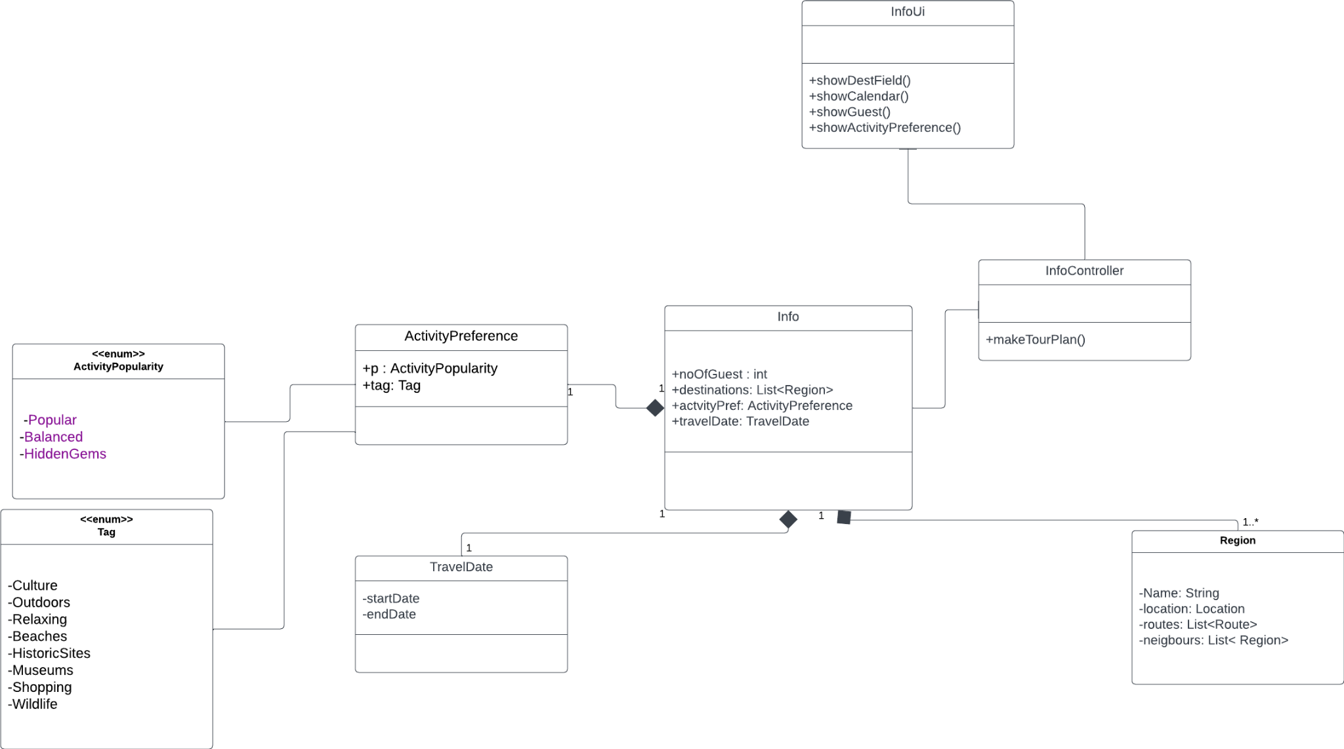
Info

Slide 3
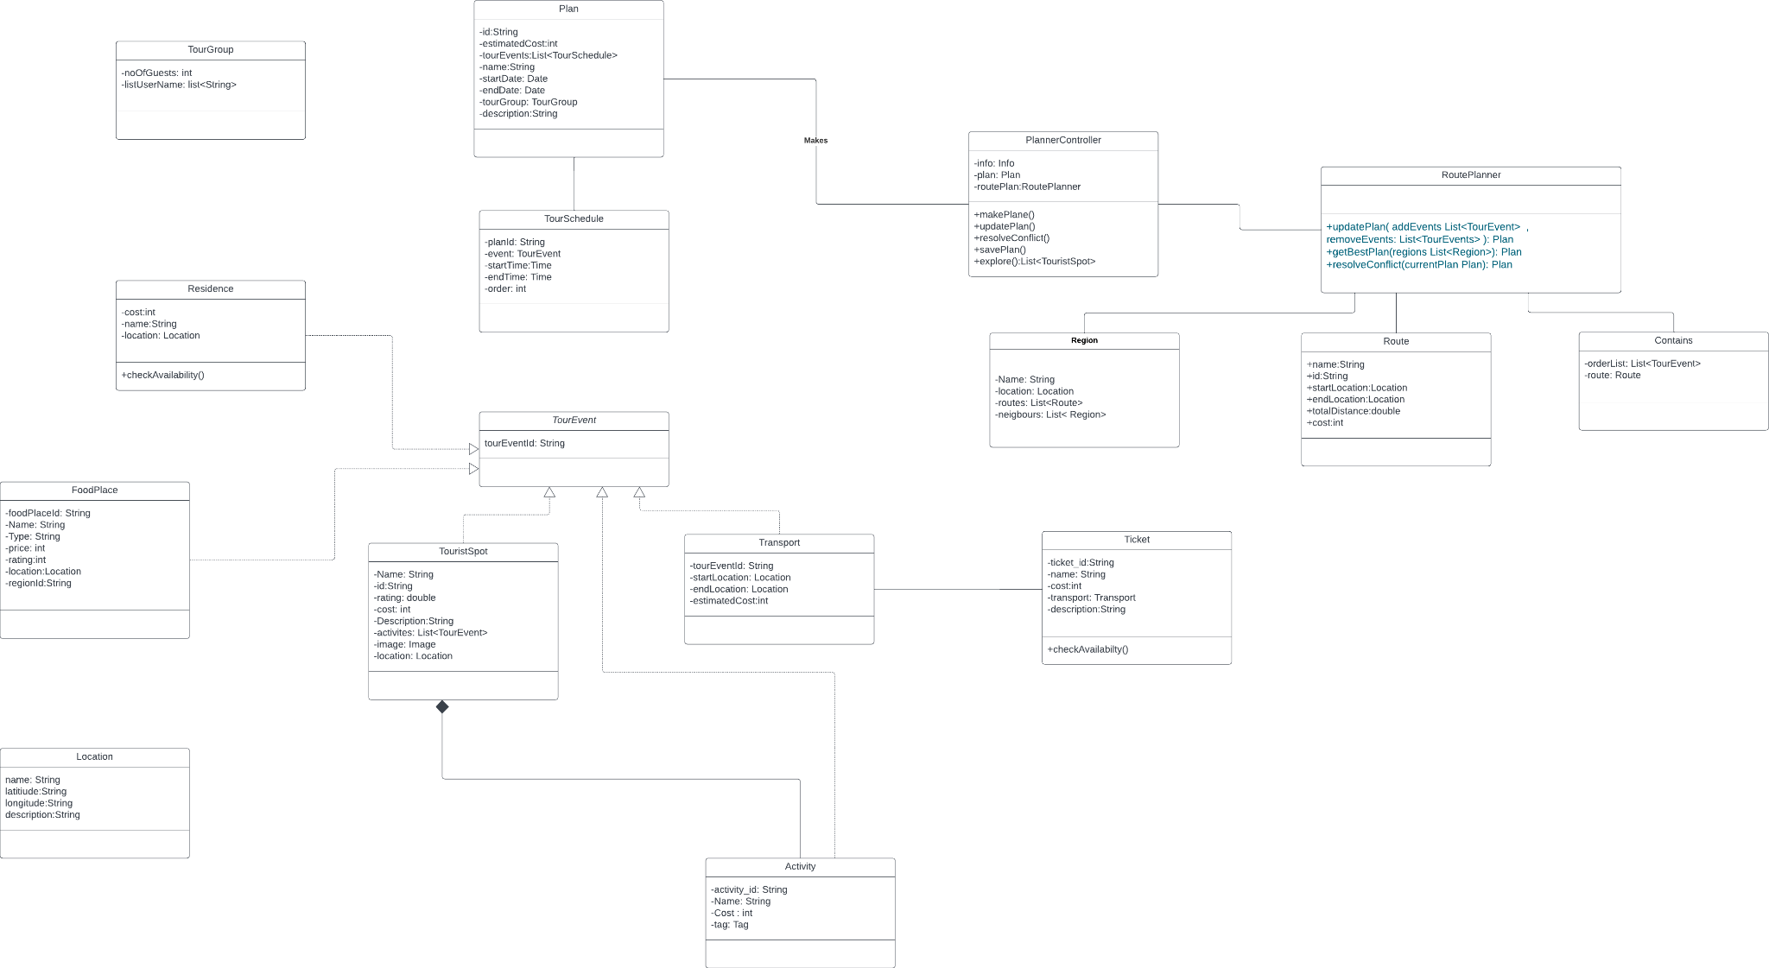
Make Plan

Slide 4
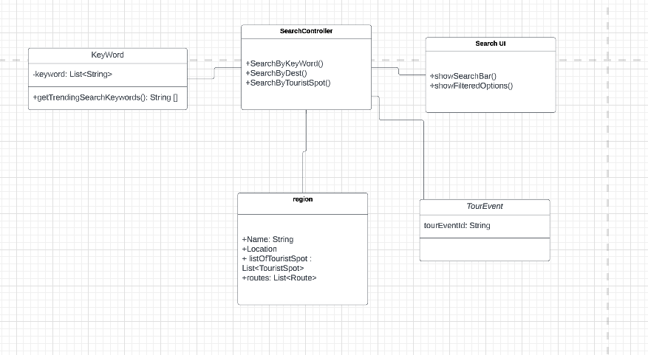
Search

Slide 5
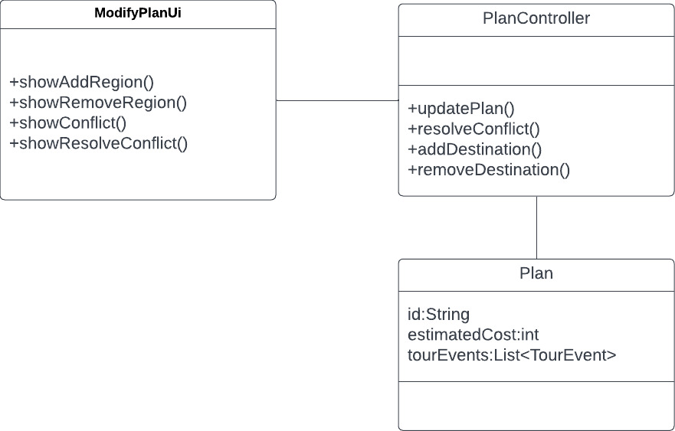
Edit Destination

Slide 6
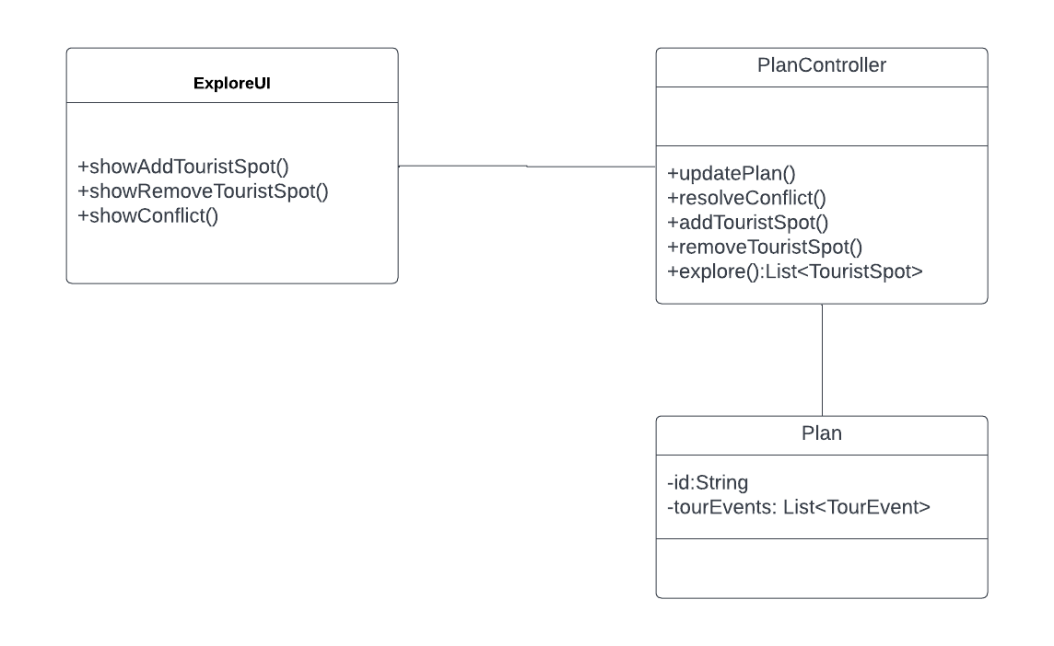
Explore(add or remove Tourist Spot)

Slide 7
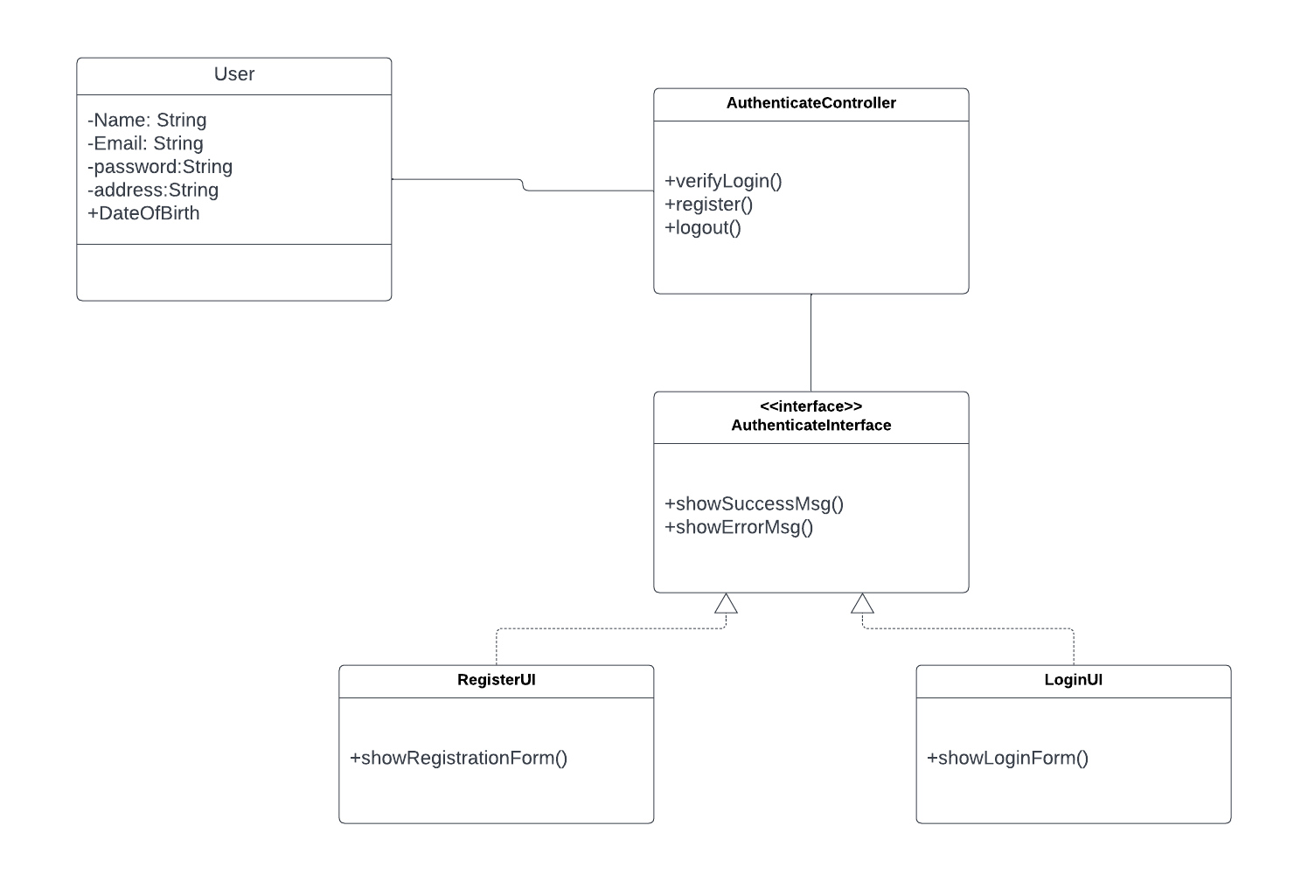
User Sign In / Sign Up

Slide 8
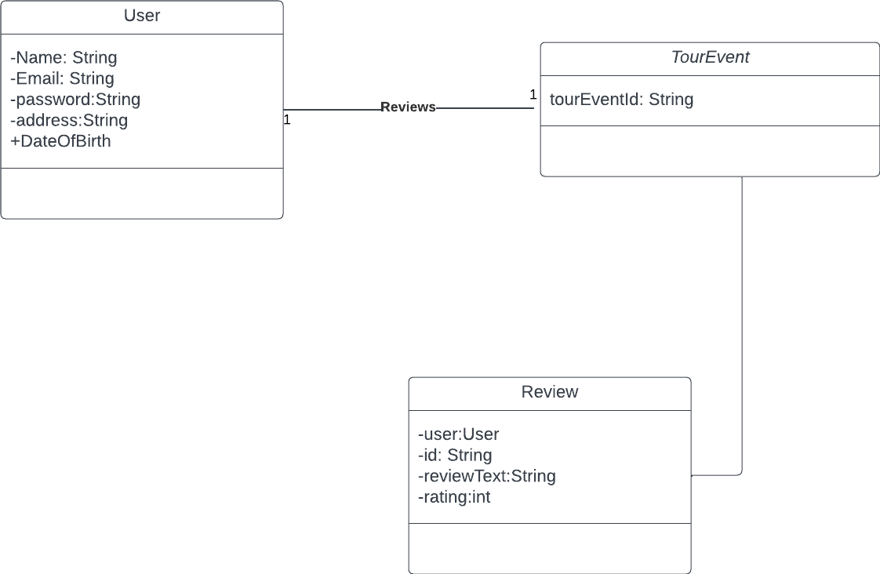
Review

Slide 9
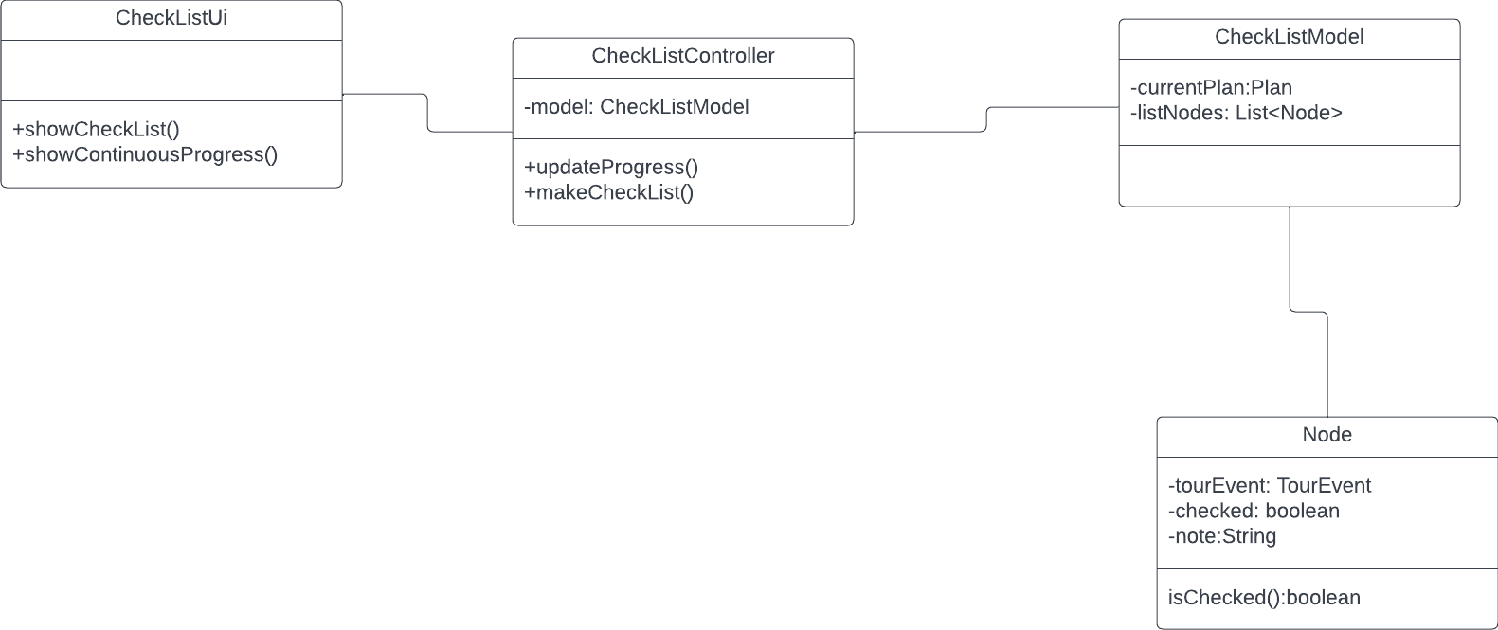
CheckList

Slide 10
Thanks

